Slide 1
How Should We Manage Relapsed T-Cell Lymphoma?
Steven T. Rosen, MD
Provost and Chief Scientific Officer
Director, Comprehensive Cancer Center
and Beckman Research Institute
Irell & Manella Cancer Center Director’s Distinguished Chair
City of Hope
Duarte, California, United States

Slide 2
Relapsed PTCL-NOS
Relapse is common
Reinduction chemotherapy followed by autologous or allogeneic transplantation may cure a limited subset
Sequential single agents may extend life expectancy and/or palliate symptoms
Clinical trials with novel agents or new combinations continue to evolve
PTCL-NOS, peripheral T-cell lymphoma not otherwise specified

Slide 3
NCCN Guidelines: Relapsed/Refractory PTCL
Non-SCT candidate
SCT Candidate
Clinical trial (preferred)
Alemtuzumab
Belinostat
Bortezomib
Brentuximab vedotin for systemic ALCL
(excluding primary cutaneous ALCL)
Brentuximab vedotin for systemic CD30+ PTCL
Cyclosporine for AITL only
Dose-adjusted EPOCH
Gemcitabine
Pralatrexate
Radiation therapy
Romidepsin
Clinical trial (preferred)
Belinostat
DHAP
ESHAP
Dose-adjusted EPOCH
GDP
GemOX
ICE
MINE
Pralatrexate
Romidepsin
CR or PR
No response
Clinical Trial
Allo SCT
HDT Auto SCT Rescue
Clinical Trial
Best supportive care
Palliative RT
National Comprehensive Cancer Network. NCCN Clinical Practice Guidelines in OncologyTM: Non-Hodgkin’s Lymphoma.V4.2014. Available at: http://www.nccn.org/professionals/physician_ gls/f_guidelines.asp. Accessed September 2014.

Slide 4
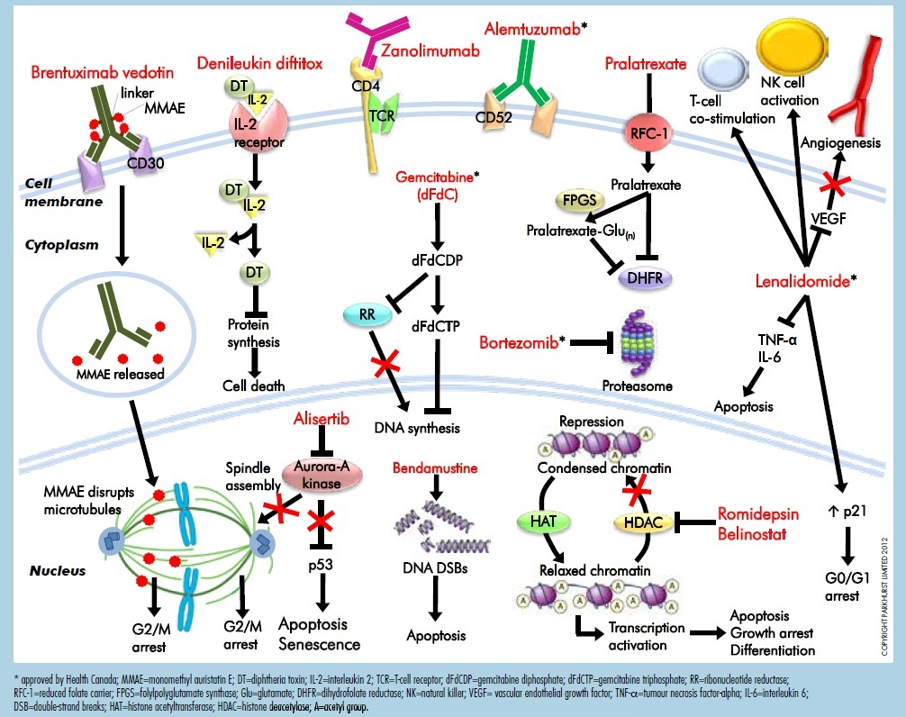
Therapeutic Options for T-Cell Lymphomas
Savage KJ, et al. Oncology Exchange. 2012;11(3):10-18.

Slide 5
Single Agents For Relapsed or Refractory PTCL
Author | Agent (off label use) | RR
Dearden et al 1991¹ | Pentostatin | 0/6
Zinzani et al 1998² | Gemcitabine | 5/8
Enblad et al 2004³ | Alemtuzumab | 5/14
Dang et al 2006⁴ | Denileukin diftitox | 8/19
Zinzani et al 2007⁵ | Bortezomib | 1/2
Czuczman et al 2007⁶ | Nelarabine | 1/8
1. Dearden C, et al. Br J Cancer. 1991;64(5):903-906; 2. Zinzani PL, et al. Ann Oncol. 1998;9(12):1351-1353; 3. Enblad G, et al. Blood. 2004;103(8):2920-2924; 4. Dang NH, et al. Br J Haematol. 2007;136(3):439-447; 5. Zinzani PL, et al. J Clin Oncol. 2007;25(27):4293-4297; 6. Czuczman MS, et al. Leuk Lymphoma. 2007;48(1):97-103.

Slide 6
PROPEL Pivotal Trial: Pralatrexate in Relapsed/Refractory PTCL
N = 115
Relapsed or refractory PTCL
Pralatrexate
30 mg/m² IV x 6 weeks in
7-week cycles*
Primary endpoint: ORR
Secondary endpoints:
DOR, OS, PFS
*No premedications were required. Patients received vitamin B12 q 8-10 weeks, and 1 mg of oral folic acid daily.
Outcome | Evaluable Patients N = 109
ORR | 29%
CR | 11%
PR | 18%
Median DOR | 10.1 months
Median PFS | 3.5 months
Median OS | 14.5 months
ORR by Histology:
PTCL-NOS: 32%; AILT: 8%; ALCL: 35%; transformed MF: 25%; other: 38%
O’Connor OA, et al. J Clin Oncol. 2011;29(9):1182-1189.

Slide 7
PROPEL Pivotal Trial Adverse Events ≥ Gr 3 Occurring in ≥3% of Patients (N = 111)
 | Any Grade | Grade 3 | Grade 4
Mucosal inflammation | 71% | 18% | 4%
Thrombocytopenia | 41% | 14% | 19%
Nausea | 41% | 4% | 0%
Fatigue | 36% | 5% | 2%
Anemia | 34% | 16% | 2%
Neutropenia | 25% | 14% | 8%
Dyspnea | 19% | 7% | 0%
Hypokalemia | 16% | 4% | 1%
Abnormal LFTs | 13% | 5% | 0%
Abdominal pain | 12% | 4% | 0%
Leukopenia | 11% | 4% | 4%
Febrile neutropenia | 5% | 5% | 0%
Sepsis | 5% | 3% | 2%
Hypotension | 5% | 3% | 1%
O’Connor OA, et al. J Clin Oncol. 2011;29(9):1182-1189.

Slide 8
Romidepsin in Relapsed/Refractory PTCL
PTCL failing ≥1 systemic therapy
N = 130
PTCL-NOS (69), AITL (27), ALCL (ALK-1-neg) (21), Other (13)
Romidepsin
14 mg/m² IV on Days 1, 8, 15 every 28 days
Primary endpoint
CR/CRu (by IRC)
Secondary endpoints
ORR, DOR
Median age: 61 years (range, 20-83)
Median of 2 prior regimens (range, 1-8)
62% refractory to frontline therapy
Outcomes | Romidepsin N = 131
CR/CRu | 15%
ORR | 25%
Median DOR | 28 months (range <1−48+)
Median PFS | 4 months
Median OS | 11.3 months
Coiffier B, et al. J Hematol Oncol. 2014;7(1):11.

Slide 9
Romidepsin in Relapsed/Refractory PTCL Toxicity
Most common AEs
Gastrointestinal disturbances, hematologic abnormalities, asthenic conditions, infections
Most common grade ≥3
Thrombocytopenia, neutropenia, infections
Only 3% of patients experienced febrile neutropenia (any grade)
Serious
Infections (19%), pyrexia (7%), vomiting (5%)
Coiffier B, et al. J Clin Oncol. 2012;30(6):631-636; Coiffier B, et al. J Hematol Oncol. 2014;7(1):11.

Slide 10
Belinostat: The BELIEF Trial
International, phase II study in patients with relapsed/refractory PTCL
N = 129
Primary endpoint: ORR
Belinostat 1000 mg/m²
d 1-5 of 21-day cycle
Median age: 63 years
Median prior cycles of treatment: 2
Median prior therapies: 2 (range, 1-8)
Outcomes | Belinostat N = 120
ORR | 26%
CR | 11%
Median DOR | 13.6 months
Median PFS | 1.6 months
Median OS | 7.9 months
In 18 patients with AITL, the response rate was 46%
O’Connor OA, et al. J Clin Oncol. 2013;31(Suppl): Abstract 8507.

Slide 11
Belinostat: The BELIEF Trial Grade ≥3 Treatment-Emergent AEs
Adverse Event | Incidence N = 129
Thrombocytopenia | 15%
Leukopenia | 13%
Neutropenia | 13%
Anemia | 12%
Dyspnea | 6%
Pneumonia | 6%
Febrile neutropenia | 5%
Fatigue | 5%
Hypokalemia | 4%
ECG QT prolonged | 4%
Deep vein thrombosis | 3%
O’Connor OA, et al. J Clin Oncol. 2013;31(Suppl): Abstract 8507.

Slide 12
Lenalidomide in Relapsed/Refractory PTCL
T-cell lymphoma*
WHO PS ≤3
Previously treated or
untreated
Not suitable for standard Tx, N = 24
Lenalidomide 25 mg PO QD, days 1-21 of 28-day cycle until disease progression, death, or unacceptable toxicity
Primary endpoint:
ORR
Secondary endpoints:
PFS, OS, safety
*Other than mycosis fungoides
Histology | N | CR | PR | ORR (%)
All | 23 | 0 | 7 | 30
ALCL | 5 | 0 | 2 | 40
AITL | 7 | 0 | 2 | 29
EATCL | 1 | 0 | 0 | 0
HSTCL | 1 | 0 | 0 | 0
PTCL | 9 | 0 | 3 | 33
ALCL, anaplastic large cell lymphoma; AITL, angioimmunoblastic T-cell lymphoma; EATCL, enteropathic-type T-cell lymphoma; HSTCL, hepatosplenic T-cell lymphoma; PTCL, peripheral T-cell lymphoma, unspecified
Median PFS = 96 days, Median OS = 241 days (range, 8-696+ days)
Common AEs
Grade 4: thrombocytopenia (33%)
Grade 3: neutropenia (20.8%), febrile neutropenia (16.7%), pain NOS (16.7%)
Dueck G, et al. Cancer. 2010;116(19):4541-4548.

Slide 13
Bendamustine in Relapsed/Refractory T-Cell Lymphomas: BENTLY Trial
N = 60
Multicenter, single-arm
phase II study
≤3 prior lines chemotherapy
Prior treatment: Median 1
T-cell lymphoma subtypes (n):
AILT (32)
PTCL-NOS (23)
ALCL (2)
EATL (1)
MF (2)
Bendamustine 120 mg/m² IV on days 1,2 every
3 weeks for 3 cycles
If no PD, additional 3 cycles of bendamustine
Primary endpoint: OR
Secondary endpoints: Safety, tolerability, DOR, PFS, OS
Outcomes
ORR | 50%
CR | 28%
Median DOR | 3.5 months
Most common grade 3/4 adverse events Neutropenia 30% Thrombocytopenia 24% Infections 20%
Damaj G, et al. J Clin Oncol. 2013;31(1):104-110.

Slide 14
Alisertib: Phase II Trials (S1108) in PTCL
Category | Response, n (%)
PTCL-NOS | 4 (31)
Angioimmunoblastic | 3 (33)
Anaplastic, ALK- | 1 (50)
Adult T-cell (HTLV-1) | 1 (25)
Extranodal NK/T-cell | 0
Adverse Event | n = 37 n (%)
Neutropenia | 12 (32)
Anemia | 11 (30)
Thrombocytopenia | 9 (24)
Mucositis | 4 (11)
Rash | 2 (5)
Barr PM, et al. J Clin Oncol. 2014;32(5s): Abstract 8523.

Slide 15
IPI-145: Oral PI3K-δ, γ Inhibitor
Selective for PI3Ks over other protein and lipid kinases
Inhibits malignant B‐cell and T‐cell survival
Direct effects on tumor cells
Disrupts tumor cell interactions within the microenvironment
PI3K Isoform | PI3K-δ | PI3K-γ
Expression | Primarily leukocytes | Primarily leukocytes
Biochemical activity (K_{D}) | 23 pM | 243 pM
Whole blood assay (IC₅₀) | 96 nM, Anti-FcƐR1 | 1028 nM, fMLP
Population | Evaluable Patients, n | Best Response, n (%) ORR CR PR SD CD
TCL | 26 | 10 (39) | 1 (4) | 9 (35) | 7 (27) | 9 (35)
CTCL | 14 | 4 (29) | 0 | 4 (29) | 7 (50) | 3 (21)
PTCL | 12 | 6 (50) | 1 (8) | 5 (42) | 0 | 6 (50)
Wagner-Johnston N, et al. J Clin Oncol. 2014. 32(5s): Abstract TPS8619.

Slide 16
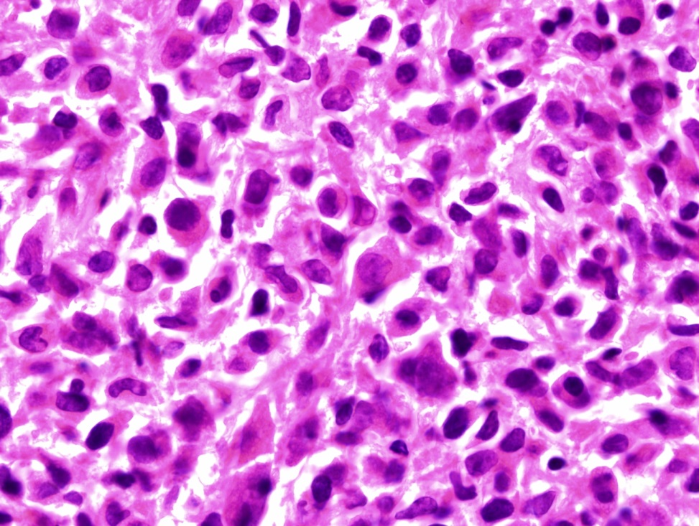
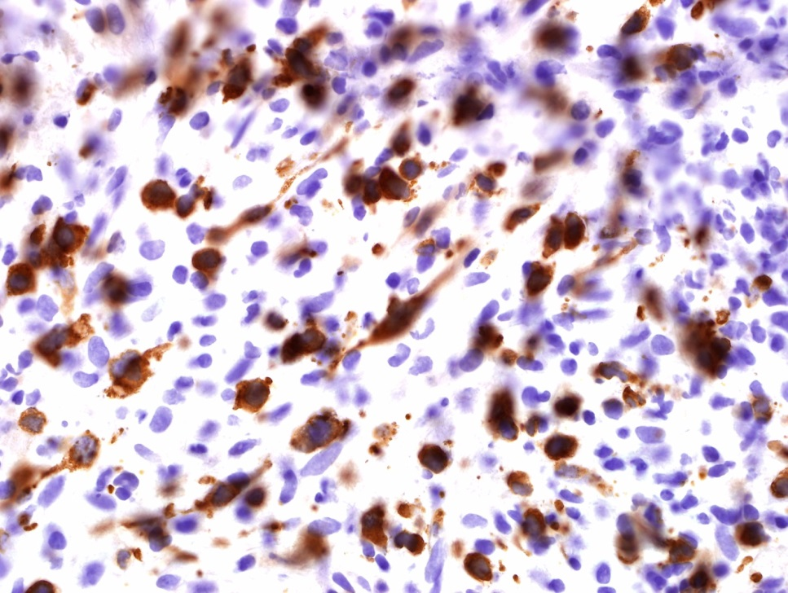
Lymph Node Biopsy
ALCL
CD30+

Slide 17
Brentuximab Vedotin: 3-Year Survival Results in Relapsed/Refractory ALCL
Phase II ongoing study
N = 58
62% primary refractory disease
26% had failed prior autoSCT
72% ALK− disease
Brentuximab vedotin
1.8 mg/kg IV every 3 weeks
up to 16 cycles
Primary endpoint:
ORR
Response / Outcome
ORR | 86%
CR | 59%
Median DOR | 13.2 months
Median DOR (for patients who obtained CR) | 26.3 months
Median PFS | 14.6 months
Median OS | Not yet reached
Median OS (for patients who obtained CR) | 7.7 months
Estimated 3-year survival | 63%
Pro B, et al. Blood. 2013;122: Abstract 1809.

Slide 18

Brentuximab Vedotin: 3-Year Survival Results in Relapsed/Refractory ALCL
100 –
90 –
80 –
70 –
60 –
50 –
40 –
30 –
20 –
10 –
0 –
Percentage of Patients Alive
N | Events | Median, Months | 95% CI, Months
58 | 21 | - | 21.3, -
ITT Patients
0 6 12 18 24 30 36 42 48
Time, Months
N at Risk (Events)
58 (0) 48 (10) 40 (17) 36 (20) 35 (21) 34 (21) 23 (21) 5 (21) 0 (21)
After median observation time of 33.4 months from first dose of brentuximab, 64% of patients with R/R ALCL were alive at time of last follow-up
Pro B, et al. Blood. 2013;122: Abstract 1809.

Slide 19
Brentuximab Vedotin: 3-Year Survival Results AEs in ≥20% of Patients
Adverse Event | Any Grade, N = 58
Peripheral neuropathy (sensory) | 41%
Nausea | 40%
Fatigue | 38%
Pyrexia | 34%
Diarrhea | 29%
Rash | 24%
Constipation | 22%
Neutropenia | 21%
Pro B, et al. Blood. 2013122: Abstract 1809.

Slide 20
Brentuximab Vedotin in Relapsed T-Cell Lymphomas
Phase II, open-label
N = 35
AITL (13)
PTCL NOS (22)
Brentuximab vedotin
1.8 mg/kg every 3 weeks until progression or unacceptable toxicity
Primary endpoint: ORR
Secondary endpoints:
Safety, correlation of
CD30 expression with
response, response
duration, PFS
Median age was 64 years
Median number of prior therapies was 2 (range, 1-9)
63% were refractory to most recent therapy
Best Clinical Response by Disease Diagnosis
 | AITL n = 13 | PTCL-NOS n = 21 | Total N = 34
Best clinical response, n (%)ª CR PR SD PD | 5 (38) 2 (15) 3 (23) 3 (23) | 3 (14) 4 (19) 3 (14) 11 (52) | 8 (24) 6 (18) 6 (18) 14 (41)
ORR, n (%) | 7 (54) | 7 (33) | 14 (41)
ªPer Cheson, as assessed by the investigator.
Horwitz SM, et al. Blood. 2014;123(20):3095-3100.

Slide 21
Crizotinib in ALK Rearranged Lymphoma
Chemoresistant
N = 11
ALCL histology: n = 9
DLBCL: n = 2
Crizotinib 250 mg
twice daily
Primary endpoint:
ORR
Response / Outcome | N = 11
ORR CR PR | 91% 82% 9%
Evidence of response by PET/CAT scan | 12 days
Open-label phase Ib
N = 15
14 patients with ALK+ ALCL
1 patient with ALK+ DLBCL
Crizotinib 250 mg
twice daily
Primary endpoint:
ORR
Response / Outcome
ORR | 60%
Clinical benefit rates (CR + PR + SD) | 67%
Median duration of treatment | 33 weeks
Redaelli S, et al. Blood. 2013;122: Abstract 368; Gambacorti-Passerini C, et al. Blood. 2013;122: Abstract 4342.

Slide 22


Autologous Transplantation in Relapsed PTCL
CIBMTR: PFS excluding pt in CR1
(Most patients ALCL)
The Stanford Experience Auto
100 –
90 –
80 –
70 –
60 –
50 –
40 –
30 –
20 –
10 –
0 –
1.0 –
0.8 –
0.6 –
0.4 –
0.2 –
0.0 –
CR1/PR1
CR2/PR2+
REF
Auto (N = 75)
Allo (N = 108)
P = Not significant
0 12 24 36 48
0 2 4 6 8 10
Months
Progression-Free Survival, Years
Benefits are unclear. Most single institution studies show low PFS rates while registry data suggest better outcomes.
CIBMTR, Center for International Blood and Marrow Transplant Research
Smith SM, et al. J Clin Oncol. 2013;31(25):3100-3109. Chen AI, et al. Biol Blood Marrow Transplant. 2008;14(7):741-747.

Slide 23
Mogamulizumab
Humanized anti CCR4 monoclonal antibody with a defucosylated Fc region
Phase I data showed activity in ATLL and CTCL
Phase II data showed ORR of 35% and CR of 14% (PTCL + CTCL)
Toxicities include skin rashes, leukopenia, neutropenia, thrombocytopenia, and increased ALT
Approved in Japan for the treatment of relapsed and refractory ATLL
Phase III study is ongoing in the US for relapsed disease

Slide 24
Summary
Treatment of relapsed T-cell lymphoma is challenging
Autologous and or allogeneic stem cell transplantation should be considered
Brentuximab vedotin can provide durable remissions in CD30+ lymphomas
Sequential single-agent therapies remain a consideration for most patients
Clinical trials are critical to advance novel agents and strategies to treat these diseases

